Slide 1
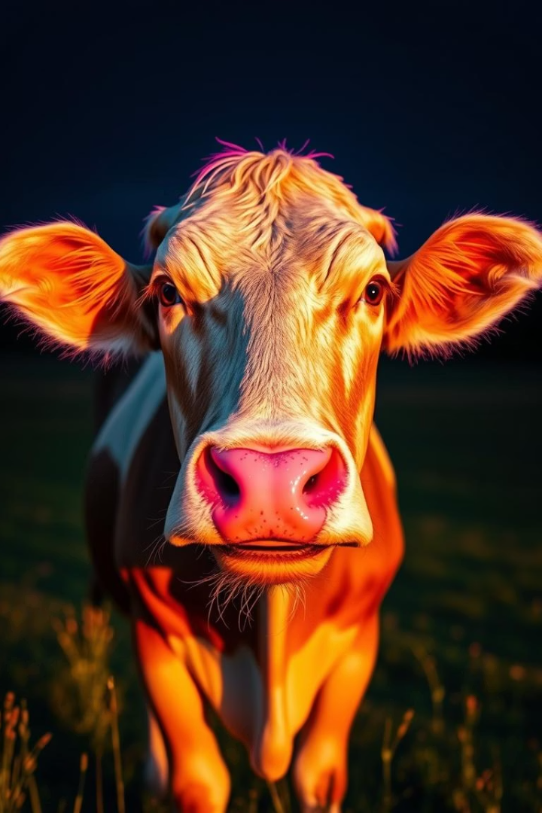

Cow Lumpy Skin Disease Detection using Deep Neural Networks
This project uses CNNs to classify images of healthy and diseased cows.
by Pappu Patel

Slide 2
Tools and Libraries Used
Python: Primary programming language for model development and data manipulation.
TensorFlow & Keras: Deep learning libraries to build and train CNN models efficiently.
NumPy: Handling numerical operations and array transformations on image data.
Matplotlib: Visualization library used to plot training progress and evaluation metrics.

Slide 3
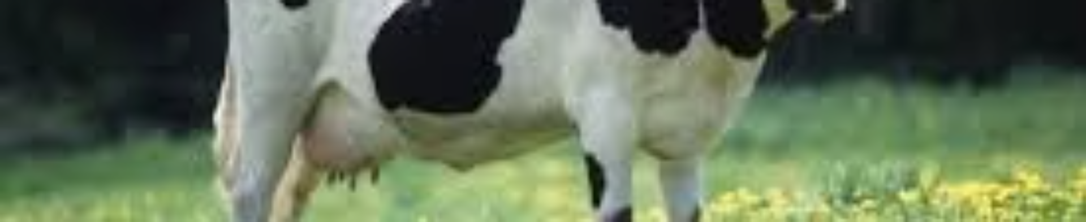
Project Objective and Dataset
Objective
Dataset
Detect cow lumpy skin disease via image classification using CNN.
Images from Kaggle, labeled as healthy or lumpy diseased cows.

Slide 4
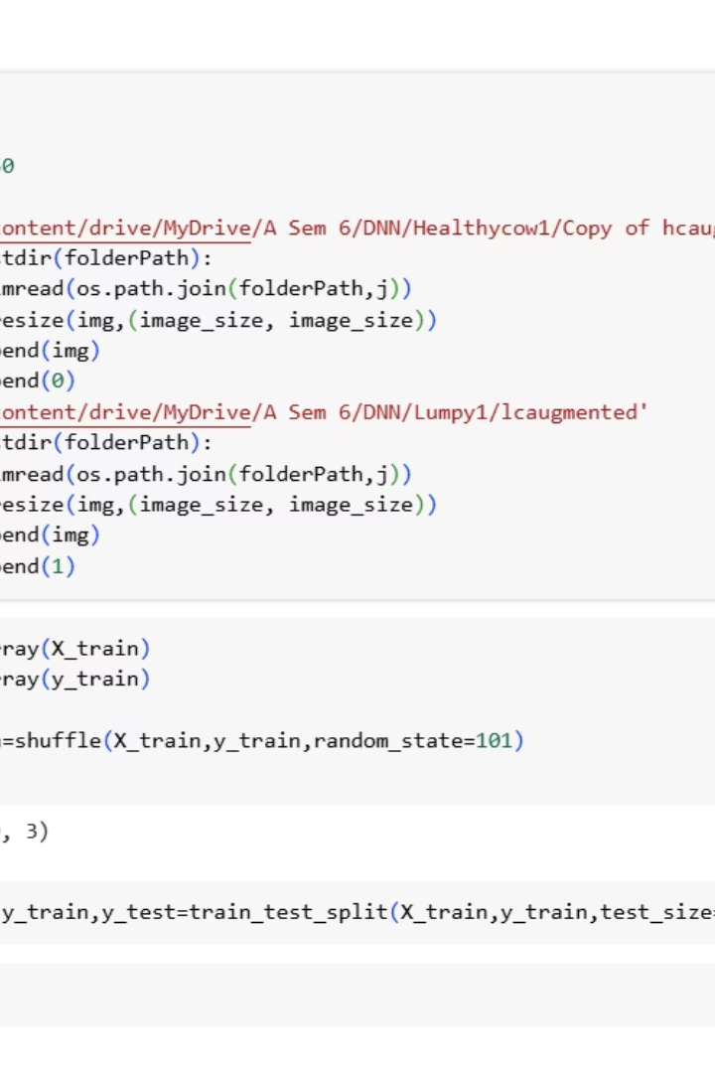
Data Preprocessing
Image Resizing
All images resized to 150x150 pixels for uniform input.
Data Preparation
Converted to NumPy arrays, labeled, shuffled, and split 90%-10% train-test.

Slide 5
Data Augmentation Techniques
Rotation and Flip
Zoom and Shift
Brightness Adjustment
Images are rotated and flipped to increase dataset variability.
Random zoom and shifts simulate different perspectives and positions.
Changing brightness helps the model adapt to different lighting conditions.

Slide 6
Data Preprocessing Details
Image Resizing: All images standardized to 150x150 pixels for consistency.
Data Conversion: Images converted to NumPy arrays to feed into the CNN model.
Labeling and Shuffling: Dataset labeled as healthy or diseased and shuffled randomly.
Train-Test Split: Data split into 90% training and 10% testing sets for evaluation.
Normalization: Pixel values normalized to improve model training efficiency.

Slide 7
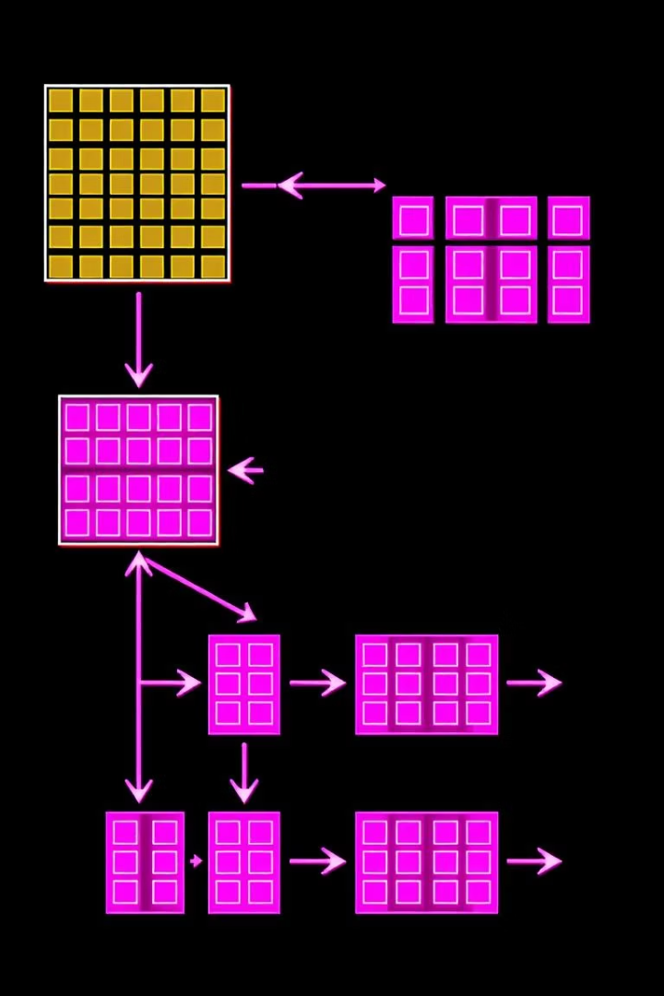



CNN Model Architecture
Convolutional Layers
Multiple Conv2D layers with ReLU activation extract features.
Pooling & Dropout
MaxPooling reduces spatial size; Dropout prevents overfitting.
Dense Layers
Flattened output fed to dense layers for classification.

Slide 8
Model Evaluation
Assessing model performance is critical to ensure accurate disease detection.
We use confusion matrices, accuracy, precision, recall, and F1 score metrics.
Metric
Definition
Accuracy
Percentage of correct predictions overall
Precision
Ratio of true positives to all predicted positives
Recall
Ratio of true positives to all actual positives
F1 Score
Harmonic mean of precision and recall

Slide 9
Model Structure and Architecture
Convolutional Layers
Pooling Layers
Extract key features from images using filters and ReLU activation.
Reduce spatial dimensions with max-pooling to lower computations.
Dropout Layers
Dense Layers
Prevent overfitting by randomly disabling neurons during training.
Classify extracted features through fully connected layers with sigmoid output.

Slide 10
Model Compilation and Training
Compilation
Training
Loss: binary_crossentropy, Optimizer: Adam, Metric: accuracy.
Model trained with dropout layers and validation split to avoid overfitting.

Slide 11
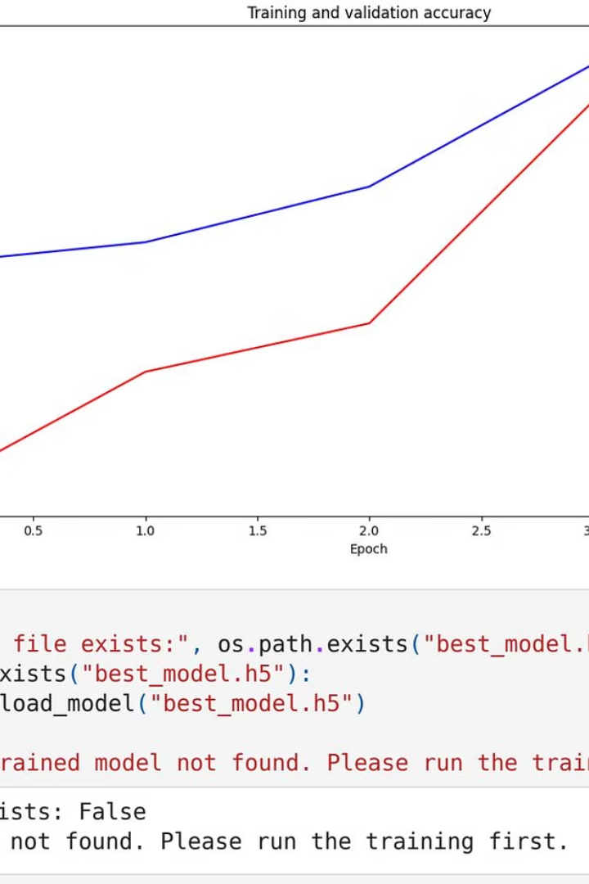
Training Results
Accuracy
Training accuracy improved up to ~69% over 5 epochs.
Validation
Validation accuracy peaked around 70%, showing moderate generalization.

Slide 12
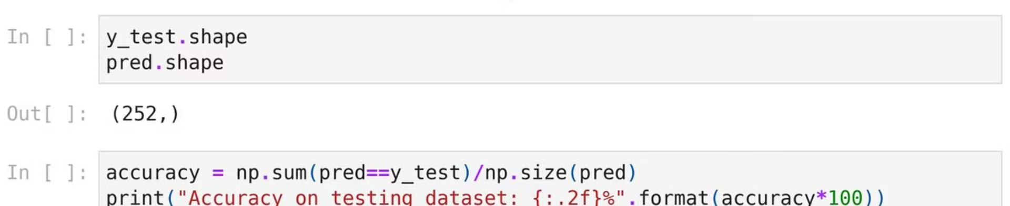
Loss Trends During Training
Training and validation loss decreased, indicating learning progress.

Slide 13
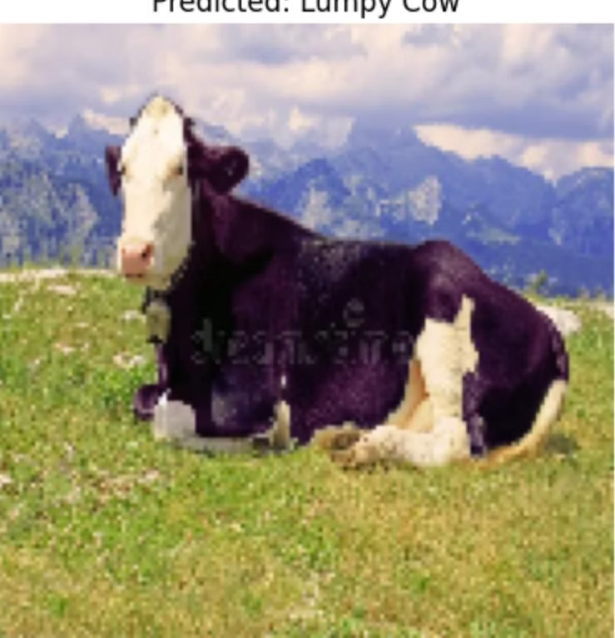
Model Evaluation and Prediction
Prediction Example
Evaluation
Model predicted "Lumpy Cow" with probabilities shown.
Tested on unseen images to assess classification accuracy.

Slide 14
Thank You
I appreciate your interest in our Cow Lumpy Skin Disease Detection project.
Project Summary
Deep learning helps improve animal health monitoring efficiently.

